Slide 1
INTELLIGENT CHATBOT FOR PREDICTION AND MANAGEMENT OF STRESS
GAYATHRI K
MES20MCA-2019
PRODUCT OWNER:MR SYED FEROZE AHAMED M

Slide 2
TABLE OF CONTENTS
1.Introduction
2.Modules
3.Data Flow Diagram
4.Table Design
5.Developing Environment
6.Product Backlog
7.User Stories
8.Project Plan
9.Sprint Plans
10.Sprint Actual

Slide 3
1.INTRODUCTION
This Project “Intelligent Chatbot for Prediction and Management of Stress” will be an application that can be integrated in website, it will give user the ability to identify the stress based on the given questions and answers. We have chosen this project because we want to provide user more easy, user-friendly, interactive way to find out about their stress. Bot will ask them few questions and according to the chosen answers, bot will show them the result and management of stress . Chatbot is a program that is designed to stimulate conversations or talk with human users. In this User communicates with the bot either with text or voice. Chatbot give logical reply or the already stored answers to the user for the questions. It is just like a user is talking to the other person. They interpret the questions and provide answer to them. They are used in messaging apps, e- commerce, etc.

Slide 4
POLARITY ANALYZER ALGORITHM
Process of computationally identifying and categorizing opinions from piece of text,and determine whether the writer’s attitude towards a particular topic or the product,is positive,negative or neutral.
Step 1:Tokenization(Dividing a para in to a different set of statements.)
Example:The Movie Was Great!
Step 2:Cleaning the Data(Remove the special characters.)
Step 3:Removing Stop Words.
Step 4:Classification
Eg:
*The
*Movie
*Was
*Great
*!
*The
*Movie
*Was
*Great
*!→
*The
*Movie
*Was
*Great
*!
Positive:+1
Negative:--1
Neutral:-0
*The
*Movie
*Was
*Great
*!
+/-
+/-

Slide 5
Step 5:Apply Supervised Algorithm for Classification. Step 6:Calculation eg:+1+0=1 Since the Polarity is greater than 0 So the given Statement is positive.(The Movie Was Great.)
*The
*Movie
*Was
*Great
*!
0
+1

Slide 6
MODULES
1.Administrator
• Login
• View registered users
• View feedback
• View complaint and reply
2.User
• Register
• Login
• Add complaint and view reply
• Chatbot
• Add feedback

Slide 7
Functional Modules CHATBOT A chatbot is a computer program that uses artificial intelligence (AI) and natural language processing (NLP). It is designed to stimulate conversations or talk with human users. In this User communicates with the bot either with text or voice. Chatbot give logical reply or the already stored answers to the user for the questions. MACHINE LEARNING Machine Learning, as the name says, is all about machines learning automatically without being explicitly programmed or learning without any direct human intervention. This machine learning process starts with feeding them good quality data and then training the machines by building various machine learning models using the data and different algorithms. The choice of algorithms depends on what type of data we have and what kind of task we are trying to automate.

Slide 8
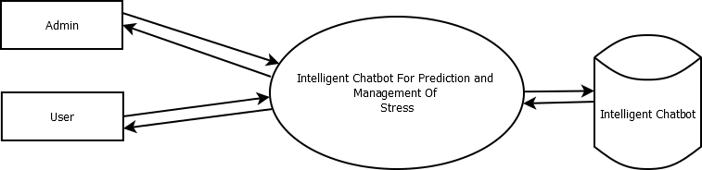
DATA FLOW DIAGRAM
Level 0

Slide 9
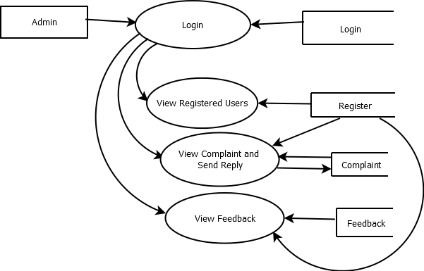
Level 1.1

Slide 10
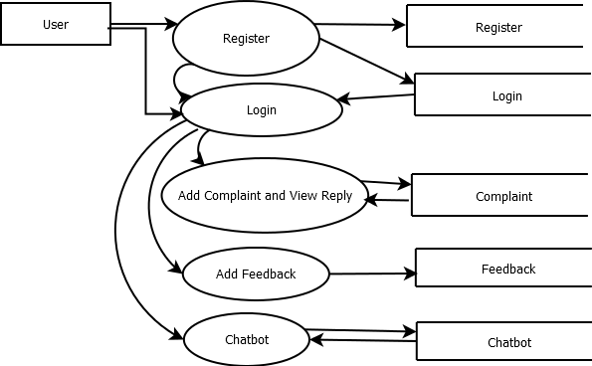
Level 1.2

Slide 11
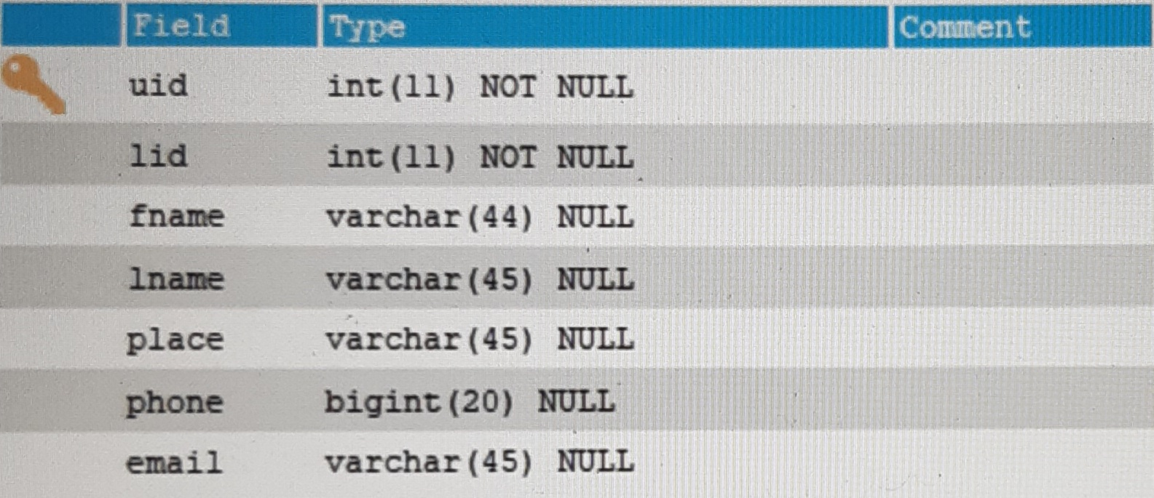
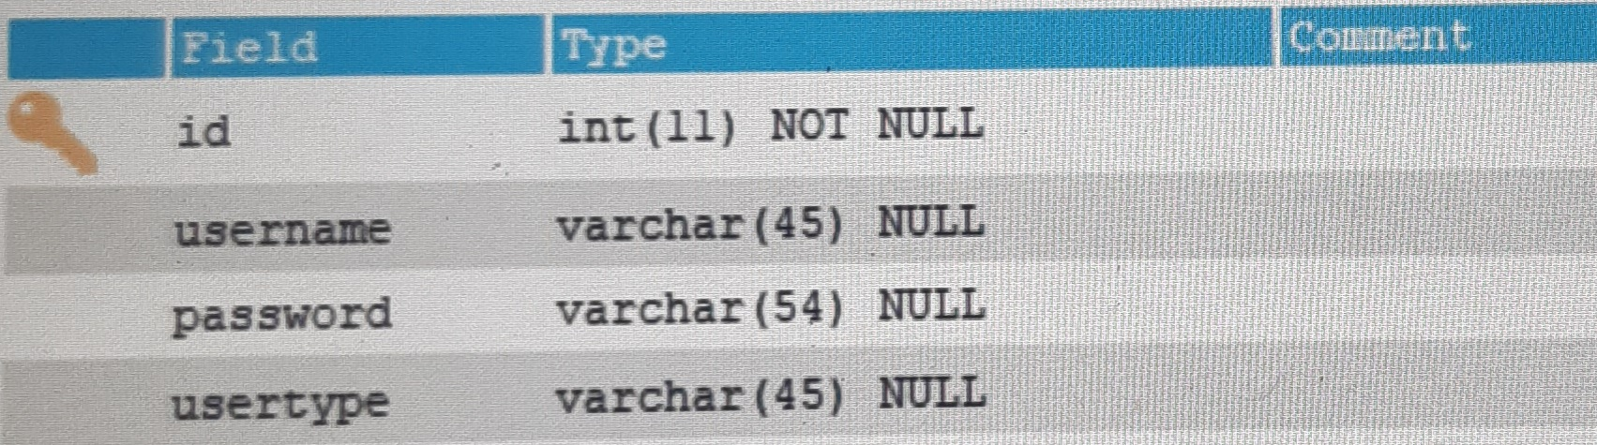
TABLE DESIGN
User
Login

Slide 12
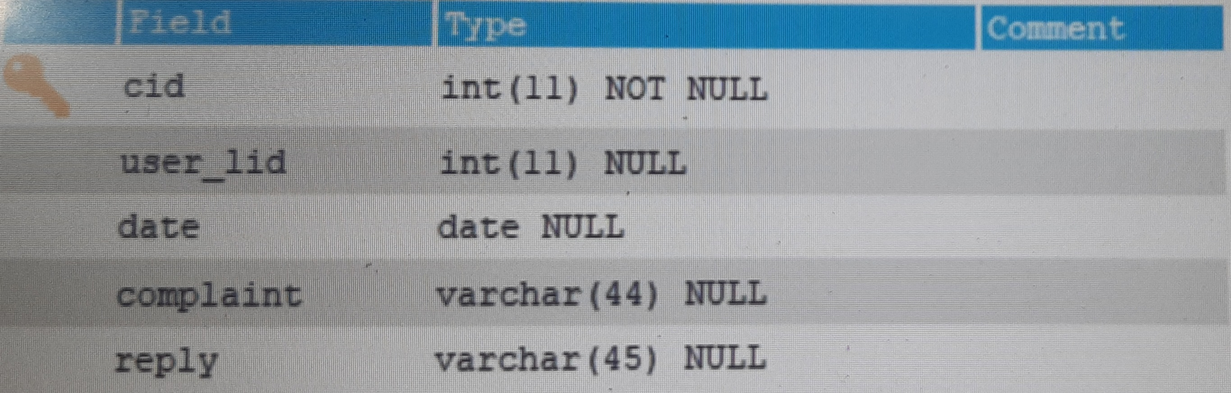
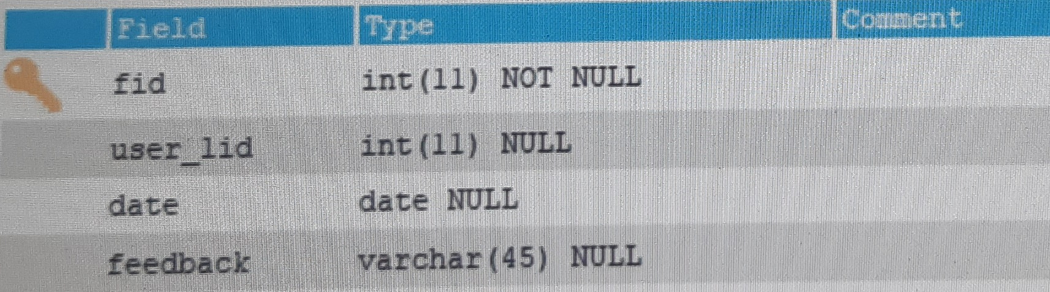
Complaint
Feedback

Slide 13
DEVELOPING ENVIRONMENT
Hardware Requirements
• Processor : 64 bit
• RAM : Min 3 GB
• Hard Disk : 10 GB
Software Requirements
• OPERATING SYSTEM: WINDOWS 10
• FRONT END: HTML, CSS, JAVASCRIPT
• BACK END: Mysql
• IDE: Jetbrains Pycharm, Android studio
• TECHNOLOGY USED: PYTHON,JAVA
• FRAME WORK USED: Flask

Slide 14
PRODUCT BACKLOG
User Story ID | Priority <High/Medium/Low> | Size (Hours) | Sprint <#> | Status <Planned/In progress/Completed> | Release Date | Release Goal
1 | Medium | 2 | 1 | Completed | 8/01/2022 | Table design
2 | High | 3 |  | Completed | 10/01/2022 | Form design
3 | High | 5 |  | Completed | 10/01/2022 | Basic coding
3 | High | 5 | 2 | Planned |  | Creation of data set
4 | Medium | 5 |  | Planned |  | Simulate conversation with human users
5 | High | 5 | 3 | Planned |  | Chat bot
6 | medium | 5 |  | Planned |  | Machine learning
7 | Medium | 5 | 4 | Planned |  | Testing data
8 | High | 5 |  | Planned |  | Output generation

Slide 15
USER STORY
User Story ID | As a type of user | I want to perform some task | So that I can achieve some goal
1 | Admin | login | login successful with correct username and password
2 | Admin | View user details | Can view registered users
3 | Admin | View Feedback | Can view user feedbacks

Slide 16
PROJECT PLAN
User Story ID | Task Name | Start Date | End Date | Days | Status
1 | Sprint 1 | 27-12-2021 | 27-12-2021 | 4 | Completed
2 |  | 28-12-2021 | 28-12-2021 |  | Completed
3 | Sprint 2 | 29-12-2021 | 29-12-2021 | 4 | Planned
4 |  | 15-01-2022 | 16-01-2022 |  | Planned
5 | Sprint 3 | 22-01-2022 | 22-01-2022 | 8 | Planned
6 |  | 23-01-2022 | 23-01-2022 |  | Planned
7 | Sprint 4 | 05-02-2022 | 06-02-2022 | 4 | Planned
8 |  | 12-02-2022 | 12-02-2022 |  | Planned

Slide 17
SPRINT PLAN
Backlog Item | Status & Completion date | Original Estimate in hours | Day 1 | Day 2 | Day 3 | Day 4 | Day 5 | Day 6 | Day 7 | Day 8 | Day 9 | Day 10 | Day 11 | Day 12
User Story#1,2 |  |  | Hours | Hours | Hours | Hours | Hours | Hours | Hours | Hours | Hours | Hours | Hours | Hours
Table design | 27/12/2021 | 5 | 5 | 0 | 0 | 0 | 0 | 0 | 0 | 0 | 0 | 0 | 0 | 0
Form design | 28/12/2021 | 5 | 0 | 5 | 0 | 0 | 0 | 0 | 0 | 0 | 0 | 0 | 0 | 0
User story #3,4
Basic coding & Facial recognition | 23/01/2022 | 10 | 0 | 0 | 5 | 5 | 0 | 0 | 0 | 0 | 0 | 0 | 0 | 0
User story #5,6
Emotion recognition & Sentiment analysis | 29/01/2022 | 20 | 0 | 0 | 0 | 0 | 5 | 5 | 4 | 4 | 2 | 0 | 0 | 0
User story #7,8
Testing & Output | 12/02/2022 | 10 | 0 | 0 | 0 | 0 | 0 | 0 | 0 | 0 | 0 | 5 | 3 | 2
Total |  | 50 | 5 | 5 | 5 | 5 | 5 | 5 | 4 | 4 | 2 | 5 | 3 | 2
Backlog Item | Status and Completion date | Original Estimate in hours | Day 1 | Day 2 | Day 3 | Day 4 | Day 4 | Day 5 | Day 6 | Day 7 | Day 8 | Day 9 | Day 8 |  |  | y 11
User Story #1 |  |  | Hours | Hours | Hours | Hours | Hours | Hours | Hours | Hours | Hours | Hours | Hours

Slide 18
SPRINT ACTUAL
Backlog item | Status & Completion date | Original Estimate in hours | Day 1 | Day 2 | Day 3 | Day 4 | Day 5 | Day 6 | Day 7 | Day 8 | Day 9 | Day 10 | Day 11 | Day 12
User Story#1,2 |  |  | Hours | Hours | Hours | Hours | Hours | Hours | Hours | Hours | Hours | Hours | Hours | Hours
Table design | 27/12/2021 | 5 | 5 | 0 | 0 | 0 | 0 | 0 | 0 | 0 | 0 | 0 | 0 | 0
Form design | 28/12/2021 | 5 | 0 | 5 | 0 | 0 | 0 | 0 | 0 | 0 | 0 | 0 | 0 | 0
User story #3,4
Basic coding & Facial recognition | 23/01/2022
User story #5,6
Emotion recognition & Sentiment analysis | 29/01/2022
User story #7,8
Testing & Output | 12/02/2022
Total |  | 50 | 5 | 5

Slide 19
THANK YOU

